Slide 2
Notes:
Arts Fort Worth is proud to partner with Artes de la Rosa and Near Southside Arts to bring back Art Aid! Together, these three organizations are offering opportunities for artists, creatives, and arts nonprofits to explore and grow their professional practice and sustain a living in the arts.
​
Formerly a full-day event, the new iteration of Art Aid is a monthly series of demonstrations and seminars geared towards artists, art nonprofits, and other creative professionals, highlighting the diverse support services available in our community. Taking place every first Tuesday of the month, each session will feature organizations and professionals who will share their expertise and help you navigate the business of making art.

Slide 3
The Fundamentals of Writing for Your Art Practice
Notes:
Does writing an artist statement, exhibition proposal, or CV feel daunting? Are you unsure where to start or what to include? Art Aid is here for you!
We've heard time and time again that artists and creatives feel overwhelmed when it is time to put pen to paper (or cursor to screen) and intuitive actions now need a black and white explanation. During our panel discussion tonight, we will walk you through the nuts and bolts of writing for your professional practice and what curators, jurors, and audiences are looking for.
On the panel are Elena Greer, Deedra Baker, and Robert Long. Each panelist will introduce themselves as they lead their portion of tonight’s discussion. Thank you all for being here tonight—we look forward to the conversation!

Slide 4
Writing an Artist Statement

Slide 5
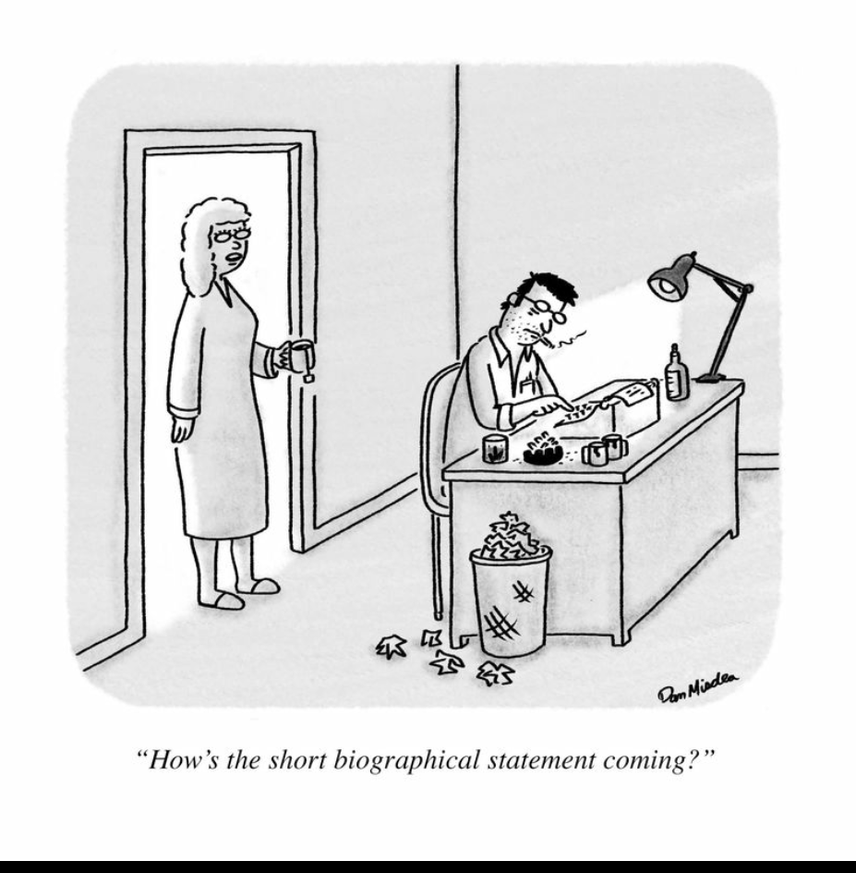
What is an artist statement?
A general introduction to your work, a body of work, or a specific project.
It should open with the work’s basic ideas in an overview of two or three sentences or a short paragraph.
The second paragraph should go into detail about how these issues or ideas are presented in the work.

Slide 6
Artist statement prompts:
Describe the content of the project, including the theme
What is the intention of the work?
Describe the inspiration for this project
What inspired you to create this work?
Describe the significance of the project
What is the larger meaning of the work?
Why is this work important?
Who does it benefit?
What does the work reveal that is original?
How does this work show a unique perspective?
To what extent does this work express the personal, to what extent the universal?
Describe the physical form and methodologies of the project
How did you create this work?
Include quantity, medium, scale, and presentation technique

Slide 7
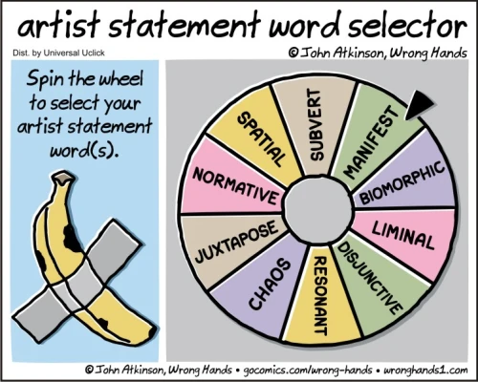
What an artist statement is NOT:
Clichés about your work and views.
Technical and full of jargon.
Long—this is not a dissertation.
Poems or prosy writing.
Nothing about your childhood or family unless it is very relevant to your work.
Not a list of your accomplishments.
Tips & Tricks:
Read it out loud.
Refresh, revise, rewrite.
Grammarly is a great (and free!) resource for writing.
Ask for help!

Slide 8
Writing an ARTIST CV/RESUME

Slide 9
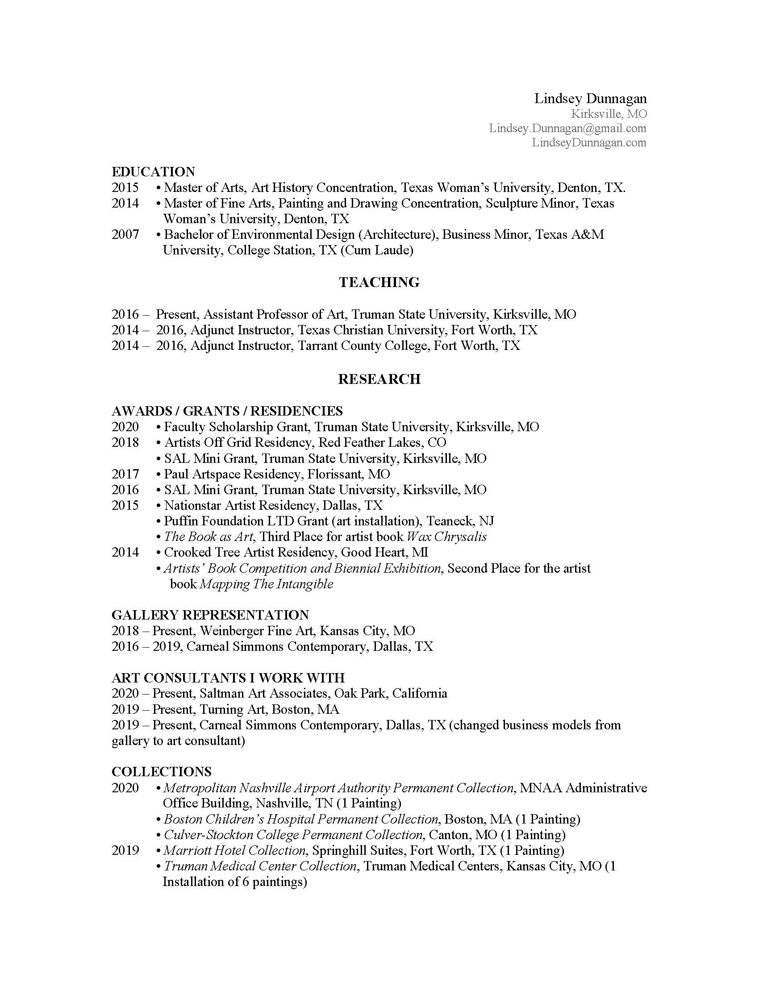
What is an artist CV/resume?
All artists should have a standard up-to-date résumé available; all résumés ideally should be tailored to specific purposes.
Therefore, artists are advised to follow a venue’s stated guidelines for submitting résumés, including the number of pages specified.
Notes:
There is a difference between a CV and an artist résumé. The CV is a record of all your professional activities, usually intended for use in academic situations as well as for applications to employment opportunities. The artist résumé is an abbreviated document, typically one to four pages in length, and is often tailored to reflect a specific expertise. The artist résumé is used in conjunction with commercial and non-profit galleries, the search for exhibition opportunities, residency and grant applications, public art proposals, etc.
Approaches to CV development can vary based on number of years in the field, area(s) of specialization, specified institutional formats, etc.
The artist résumé conventions presented here are designed primarily for use in proposals to professional venues, which can include commercial and non-profit galleries, museums, and art centers. These recommendations can also be followed when submitting a résumé for grants, residency programs, commissions, and other exhibition opportunities. The artist résumé is increasingly used as an essential element on artist and gallery websites and may also be used in publications such as exhibition catalogues. Avoid making the artist résumé complicated; it is meant to be short and simple to review. Normally the artist résumé is succinct (one to four pages in length) and is similar to the short curriculum vitae or short CV.
All artists should have a standard up-to-date résumé available; all résumés ideally should be tailored to specific purposes. Therefore, artists are advised to follow a venue’s stated guidelines for submitting résumés, including the number of pages specified.

Slide 10
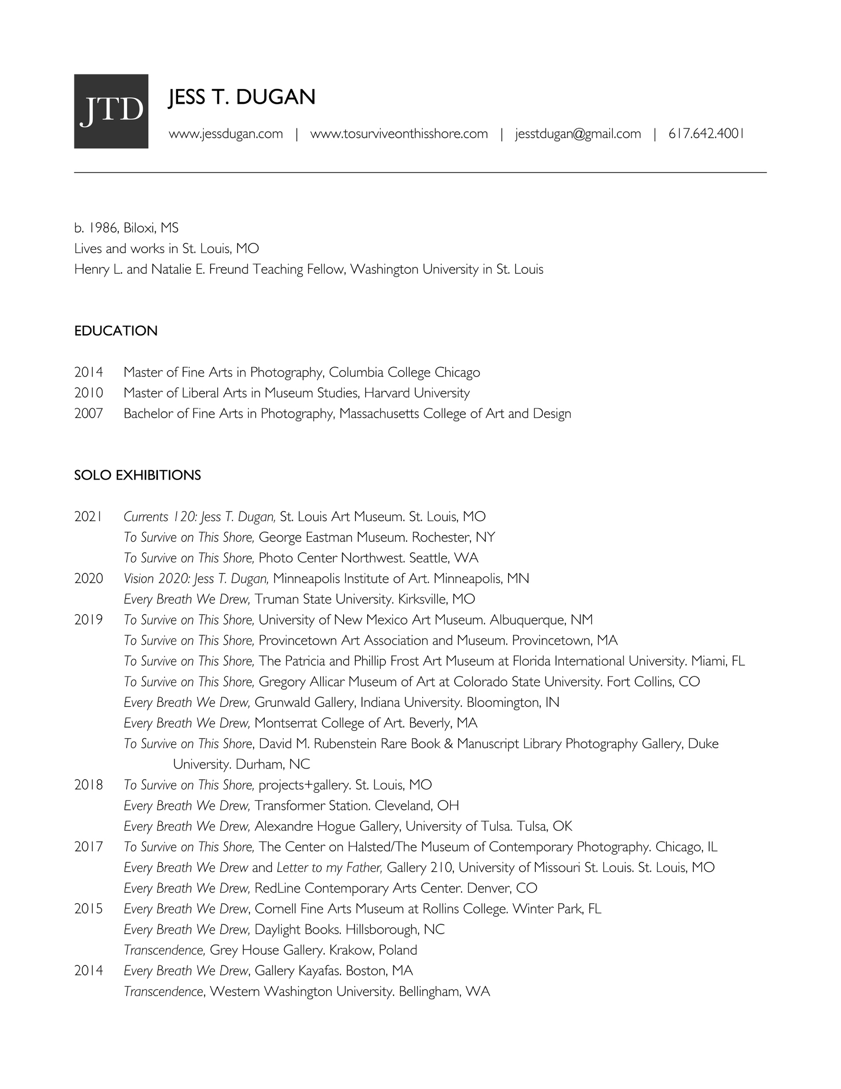
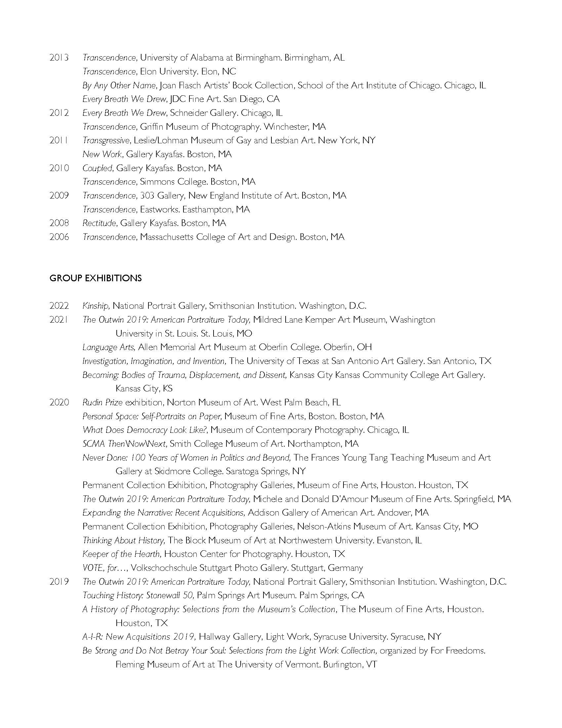
CV/resume examples:
Notes:
A current good practice is to save your résumé as both PDF and Word files. Maintain an up-to-date copy of your résumé as a Word document because it is the easiest format to edit and update. A PDF file is the ideal format to submit with applications or for display because spacing, margins, and formatting are retained across computer platforms. If no submission directions are given, or if an institution gives you the option of sending a Word document or a PDF, you should always choose to send a PDF.
Both the résumé and the CV should list entries within each category in reverse chronological order (i.e., placing the most recent entry first and so on, with the least recent entry being the last entry in each category). Exceptions to this convention are entries without dates under categories such as Collections or Gallery Affiliation. In these cases entries should be listed in alphabetical order. Another exception to using reverse chronology is found under Education, where you should list institutions attended without earning a degree after listing schools (in reverse chronology) where degrees were earned.
Depending on your individual strengths as an artist, you may choose to rearrange the recommended order of some of the categories found below. For example, you may choose to put your exhibitions first, before any awards or honors. As a general rule, you should “play to your strengths” by placing more important, relevant, and recent information near the beginning of your résumé. Otherwise, the order recommended below is a good one to follow. (For obvious reasons, do not list category headings that are not relevant to you.)

Slide 11
Artist CV/resume statement prompts:
Contact Information
Name
Address
Telephone Number
Email
Education
Awards and Grants
Exhibition Record
Solo
Collaborative Projects
Group
Juried
Commissions
Collections
Bibliography
Print Media
Online Periodicals/Publications
Blogs
Publications as Author
Teaching Experience/Related Experience
Lectures/Workshops
Curatorial Projects
Gallery Affiliations
References

Slide 12
Writing EXHIBITION PROPOSALS

Slide 13
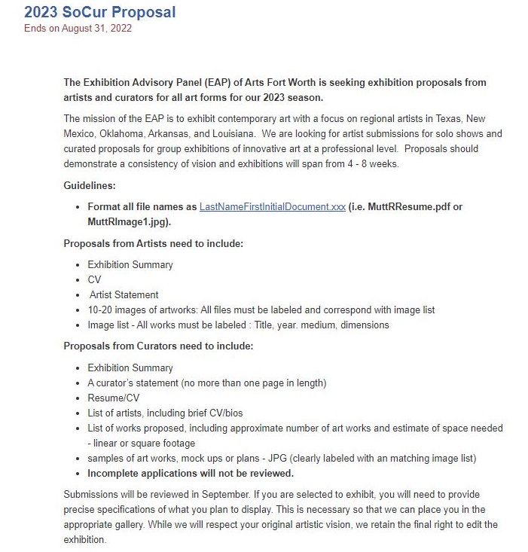
Follow application instructions:
Notes:
Make sure you complete it and carefully follow all instructions. For most galleries, they will not consider your application unless you have supplied what they asked for in the form that they asked for it.
Spend some time on the finer details and review before submitting.

Slide 14
Use clear, concise language:
This exhibition will provide a means to reflect upon the growth of Fort Worth, as the photographs document a time when the city was spreading into previously undeveloped areas. These images can be contrasted with the current construction boom in which many of those places seen in Wood’s photographs are now being redeveloped and repurposed. The exhibition is not only historical in focus but also provides an opportunity to consider photographic objectivity and inclusion. Wood’s photographs are not reportage; they were not taken to document the city but rather as part of a commercial enterprise. The archive of images that is left shows only a limited aspect of Fort Worth, the pictures commissioned by those with financial means or political interest in the areas that his camera captured.
This subject of commerce is contrasted with Wood’s photographic style which asserts its objectivity through an unambiguous approach to subjects, and the accumulation of Wood’s photographs provides a useful mirror to consider questions of objectivity in other photographic practices, such the New Topographics and Walker Evans. It is hoped that the exhibition will also provide a useful mechanism to reflect on wider questions as to what objectivity means within art and curatorial practices.
Notes:
Use your artist statement as a jumping off point and focus on the body of work you are presenting for exhibition (The What & The Why). The exhibition proposal should not only support the work but allow the reader to understand the work before they look at a single image. Consider what’s most important to the gallery you’re submitting your proposal to, and what value your artwork will bring to them & the community.

Slide 15
Be specific about what the exhibition will be:
Bill Wood (1912-1973) was a commercial photographer in Fort Worth from 1937 to 1970. He operated as a photographic general practitioner, taking pictures of whatever, he was paid to. At the studio at 1209 Throckmorton Street, he’d do portraits and product images, but a greater part of his business was derived from commissions to photograph things around the city: new tract housing developments, store openings, and streetscapes. Across this diverse portfolio of subjects, Wood’s images are consistent in their deadpan approach. There is little drama in the photographs—they show the subject as it is, with simple lighting, straight-on composition and little human drama.
This exhibition will be composed solely of Bill Wood photographs of buildings, urban scenes and construction in Fort Worth, taken during the 1950s and 60s while the city was undergoing a considerable boom in population and construction. In subject matter, these images can appear as the counterpoint to Walker Evans’ photographs taken for the Farm Security Administration of the dilapidated buildings of Dust Bowl era America. Wood’s photos share a similar objective style to Evans’ but instead document the urban development which followed that blighted period of American history—where Evans’ photographs show a landscape in ruin, Wood’s document the optimism of the post-war boom.

Slide 16
The real estate developments depicted in his photographs are often new encroachments onto previously untouched land. In this regard, Bill Wood’s pictures serve as a precursor to the New Topographics movement of the 1970s, a group of American photographers (such as Lewis Baltz 1945-2010 and Joe Deal 1947-2010) who used a similar deadpan approach to document suburban development and its relationship to the natural landscape.
For this proposed exhibition at FWCAC, around 20-30 photographs would be displayed, all drawn from the curators’ own collection. There is the further possibility of collaborating with the Special Collections Library at University of Texas, Arlington, where a large holding of Bill Wood photographs and negatives are held.
Ideally, the exhibition would be installed in one of FWCAC smaller spaces, with a preference for the Vista Gallery. The photographs will be framed, most individually but some in pairs where the images depict the same location from different viewpoints. The exhibition will be installed as a disrupted grid in which spaces are left. Examples of the paired framing can be seen in the attached images BW-6353-53-11 and BW-8989-68; and the proposed installation is shown in the image ‘Layout.’

Slide 17
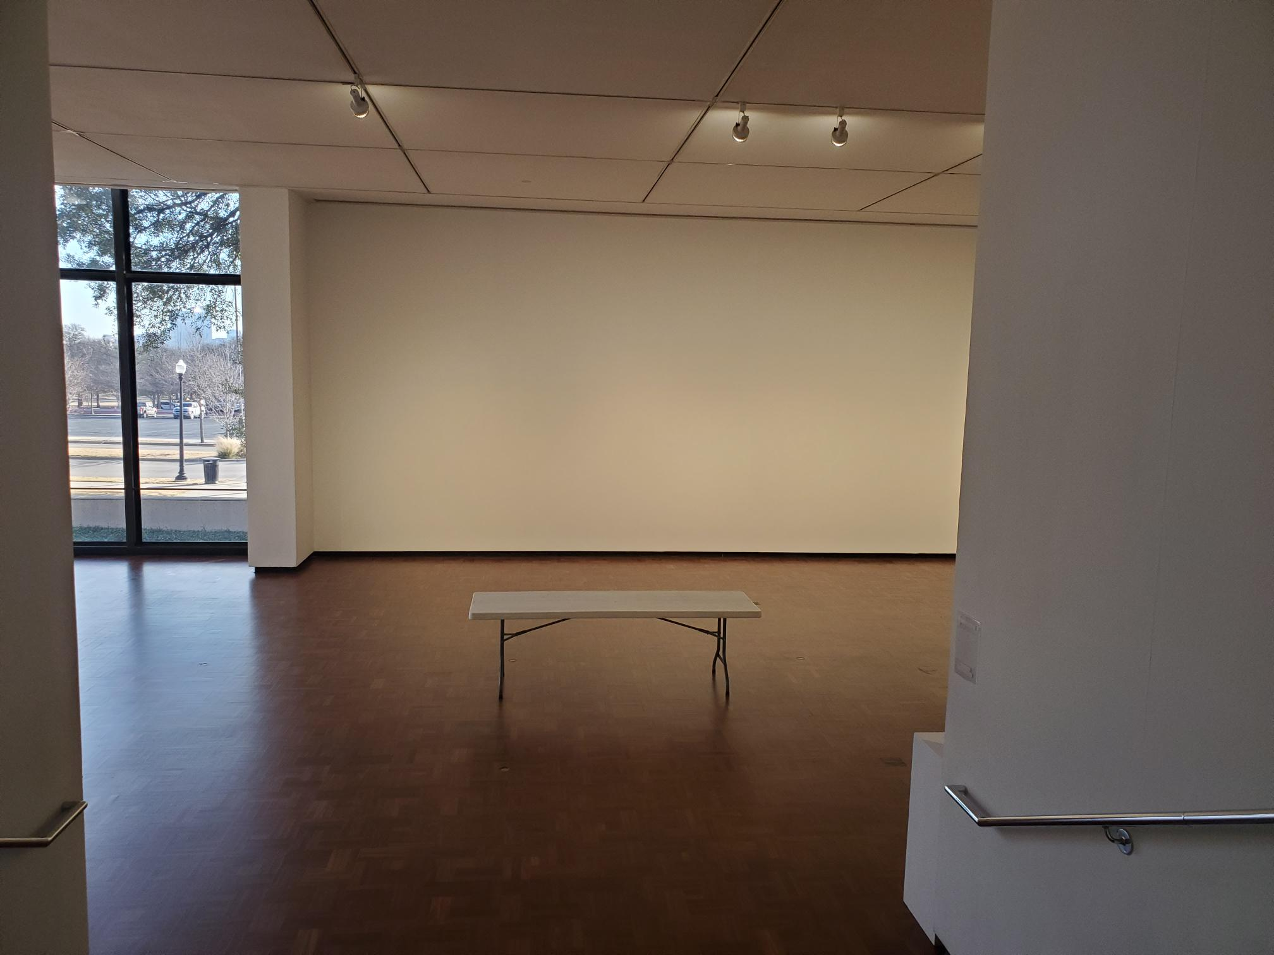
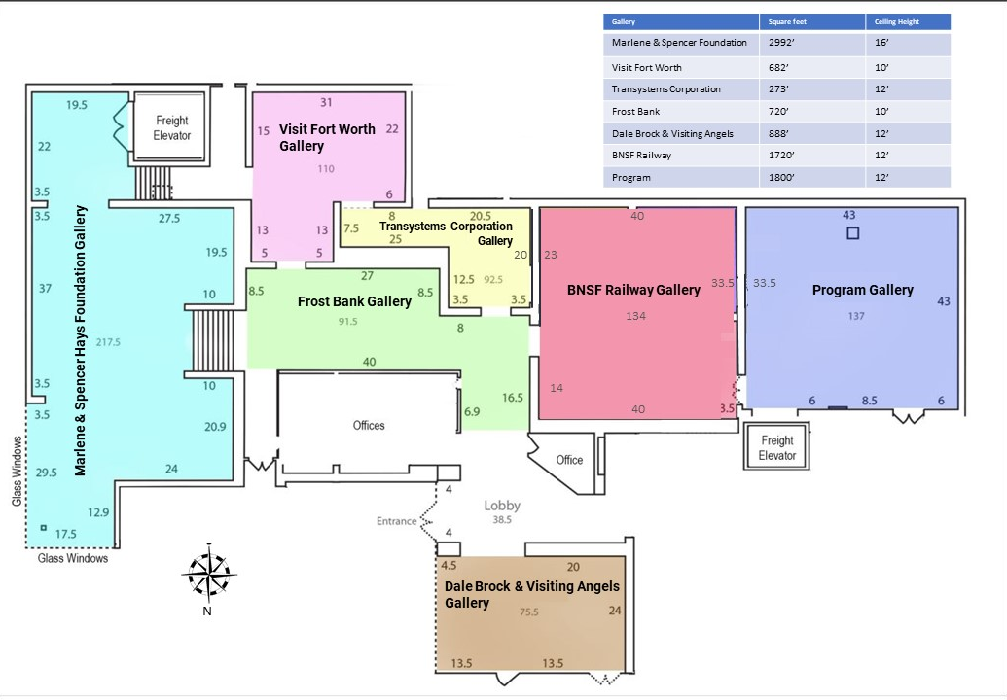
Visit the gallery:
Understanding the space you are submitting a proposal to is vital.

Slide 18
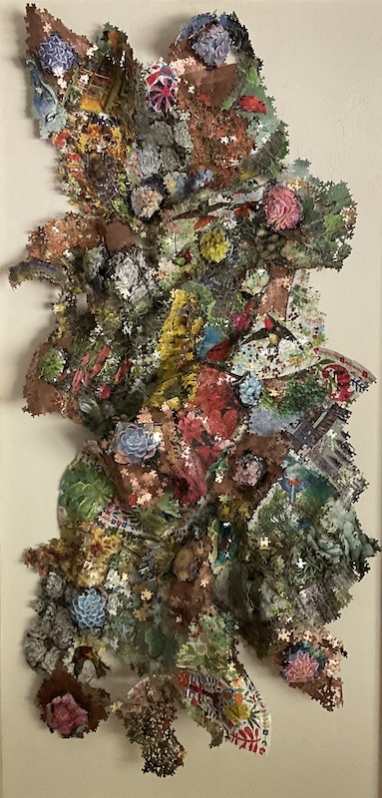
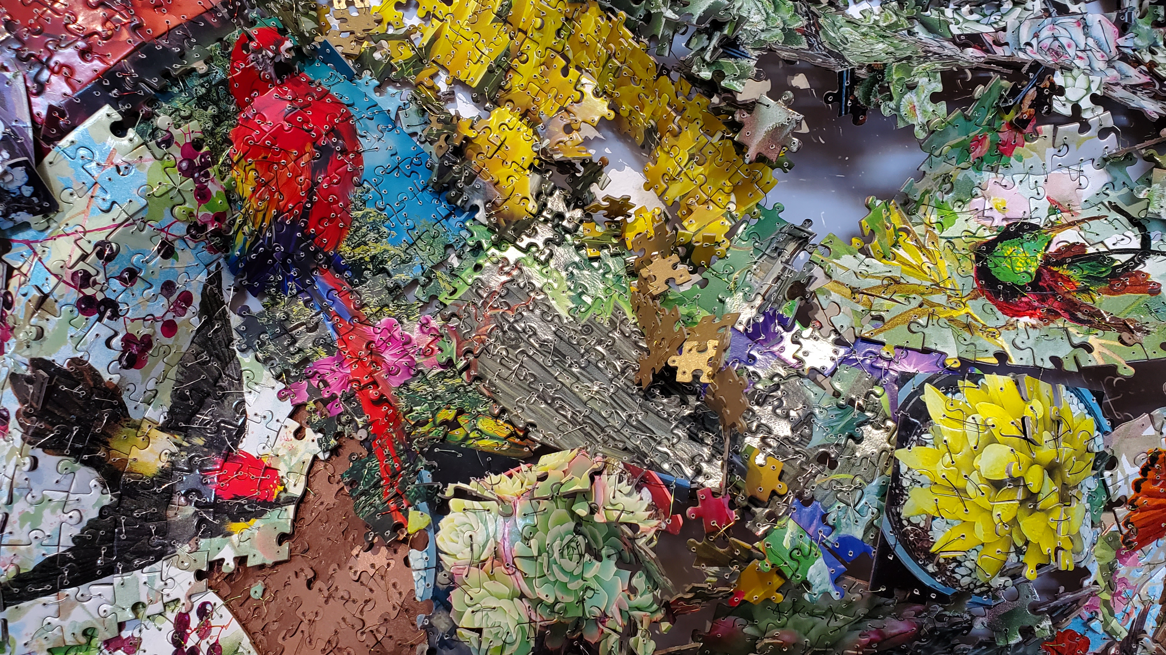
Send quality photographs:
Create art documentation of 2D and 3D artworks with proper technical execution, including accurate exposure, sharp focus, and proper orientation of artwork.
Notes:
They need to look as professional as possible. The finished product should be clear, in focus, lit correctly, etc. It is extremely difficult to capture the nuance of a 2d or 3d work, including detail shot(s) can help the gallery understand your work more clearly. Make your artwork look the very best it can in photograph form.

Slide 19
Questions?
talkto@artsfortworth.org
www.artsfortworth.org
@artsfortworth

Slide 20
Questions?
Elena Aredondo Greer
817-298-3041
egreer@artsfortworth.org
Deedra Baker
deedrabaker.com
deedra@deedrabaker.com
Robert Long
rlong@artsfortworth.org

